Slide 1


Water world
https://climate.nasa.gov/news/3012/nasa-led-study-reveals-the-causes-of-sea-level-rise-since-1900/
What does thermodynamics have to say about this?

Slide 2
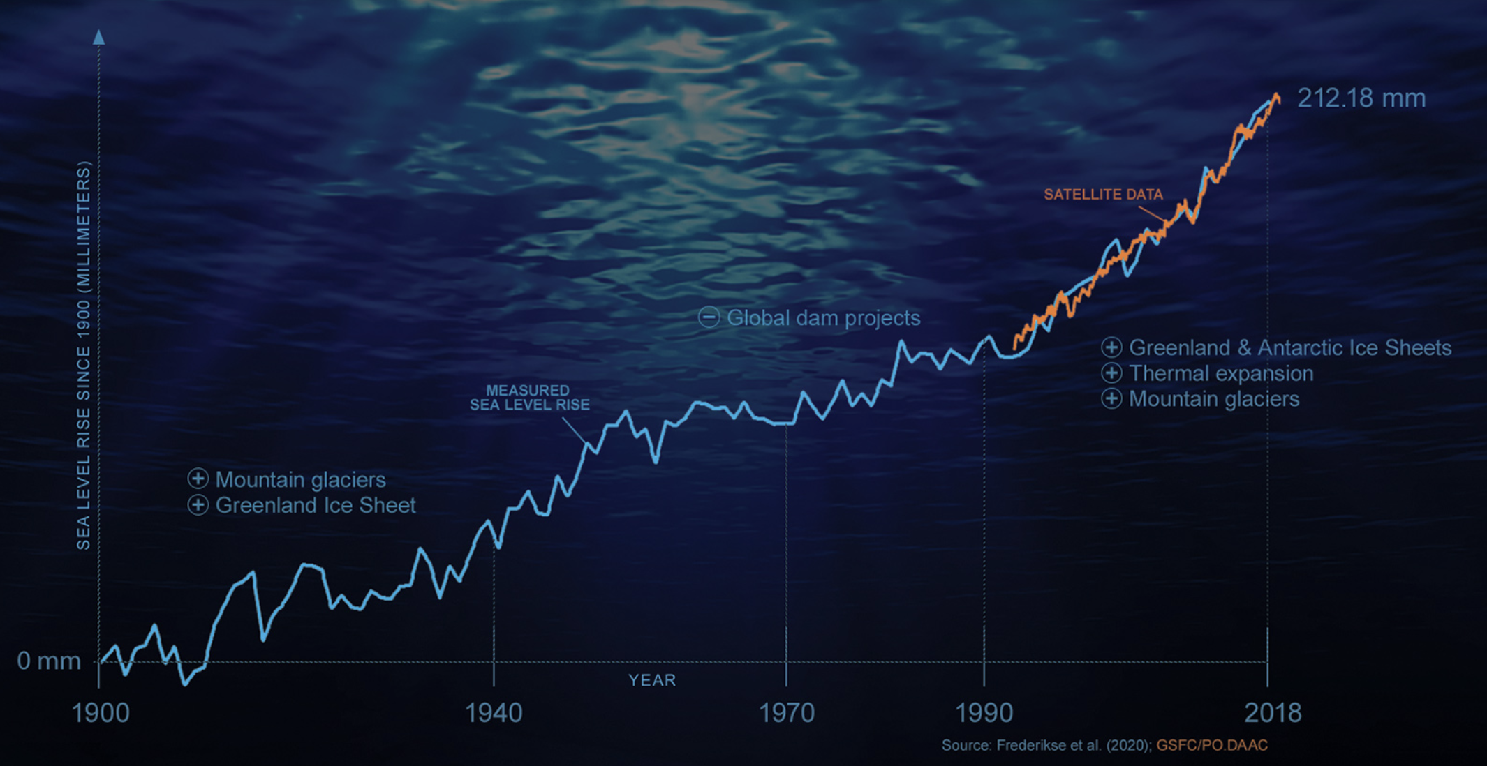
Thermodynamics and global sea level rise
https://climate.nasa.gov/news/3012/nasa-led-study-reveals-the-causes-of-sea-level-rise-since-1900/
What does thermodynamics have to say about this?

Slide 3
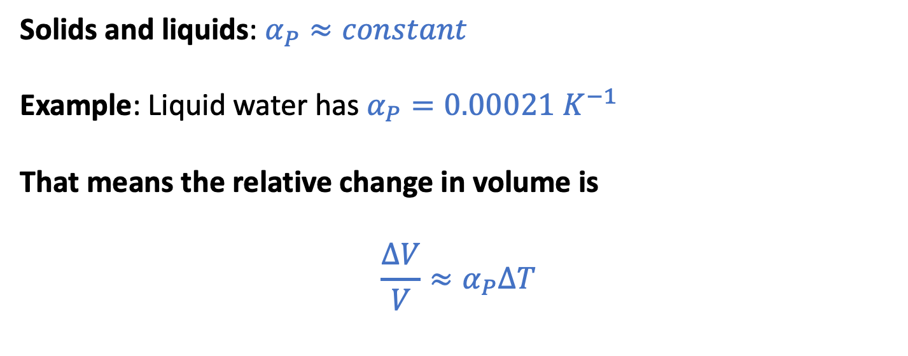


The “Isobaric thermal expansivity”
$$α_{P}≡\frac{1}{V}{\left(\frac{∂V}{∂T}\right)}_{P}$$
$$∆V$$
Solids and liquids: $α_{P}≈constant$
Example: Liquid water has $α_{P}=0.00021{ K}^{−1}$
That means the relative change in volume is
$${\frac{∆V}{V}≈α}_{P}∆T$$
$$V$$

Slide 4



The “Isobaric thermal expansivity”
$$α_{P}≡\frac{1}{V}{\left(\frac{∂V}{∂T}\right)}_{P}$$
For a given column of water, this means
$${\frac{∆h}{h}≈α}_{P}∆T$$
or
$$∆h {≈h α}_{P}∆T$$
$$∆h$$
$$h$$

Slide 5
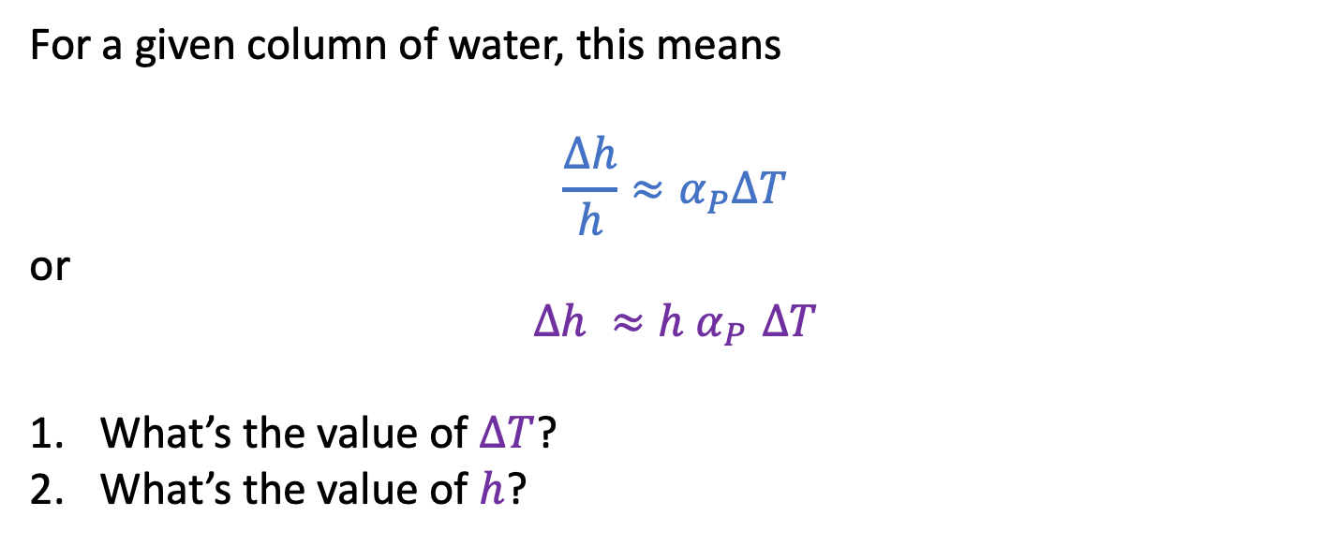
The “Isobaric thermal expansivity”
$$α_{P}≡\frac{1}{V}{\left(\frac{∂V}{∂T}\right)}_{P}$$
For a given column of water, this means
$${\frac{∆h}{h}≈α}_{P}∆T$$
or
$$∆h {≈h α}_{P}∆T$$
What’s the value of $∆T$?
What’s the value of $h$?
$$∆h$$
$$h$$

Slide 6
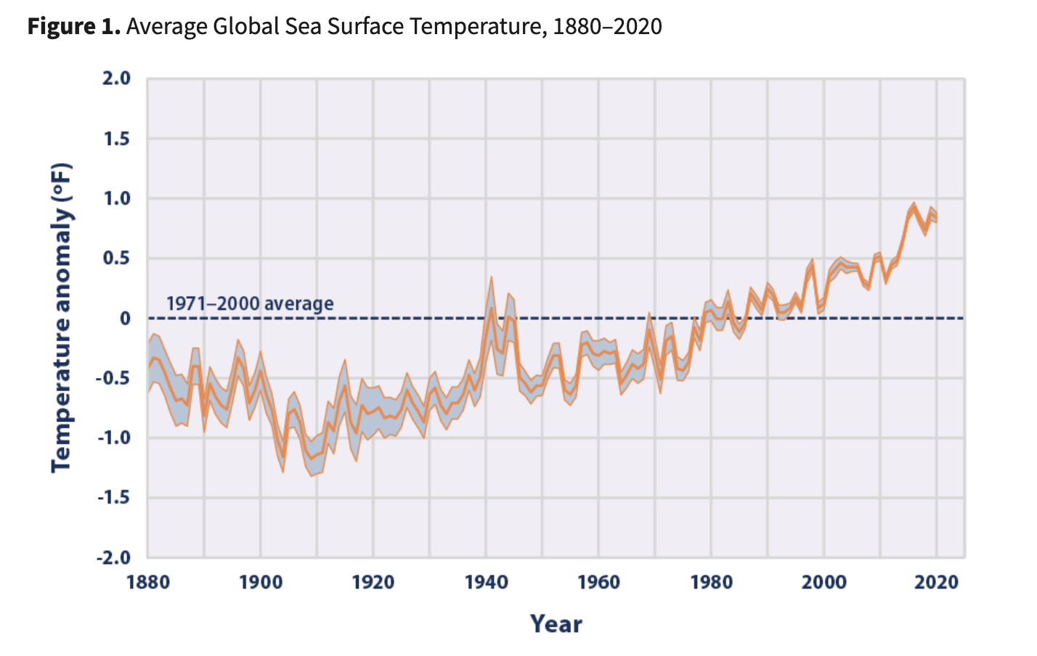


Global sea surface temperature, 1880-2020
$$∆T= 1.5 ℉= 0.8 K$$
Looks like $∆T$ for the ocean surface is $\sim 0.8 K$
https://www.epa.gov/climate-indicators/climate-change-indicators-sea-surface-temperature

Slide 7
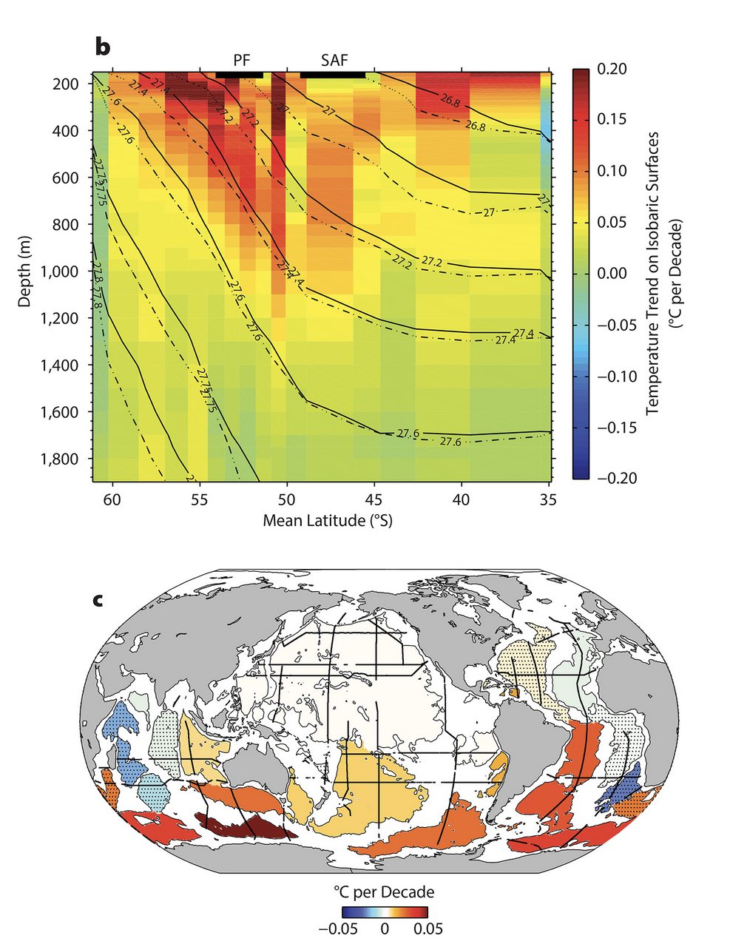

Depth of the warming (Southern Ocean)
Looks like $h$ for the ocean is $\sim 1000 m$
(we’d have to do an integration to get this right)
https://tos.org/oceanography/article/southern-ocean-warming

Slide 8
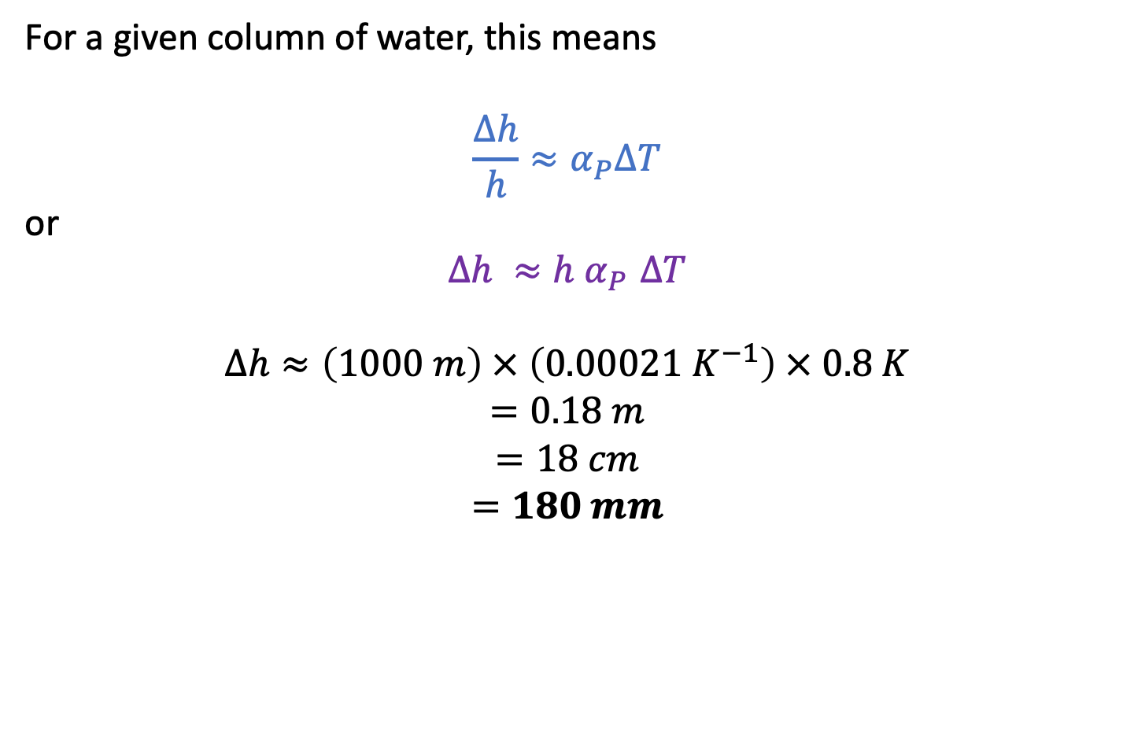
Predicting sea level rise due to thermal expansion
$$α_{P}≡\frac{1}{V}{\left(\frac{∂V}{∂T}\right)}_{P}$$
For a given column of water, this means
$${\frac{∆h}{h}≈α}_{P}∆T$$
or
$$∆h {≈h α}_{P}∆T$$
$$∆h≈\left(1000 m\right) × \left(0.00021{ K}^{−1}\right) × 0.8 K$$
$$=0.18 m$$
$$=18 cm$$
$$=180 mm$$
$$∆h$$
$$h$$

Slide 9

Other contributors to sea level rise
Thermal contribution = $180 mm$
So … Thermal expansion could account for $\sim 80\%$ of the observed sea level rise so far.

Slide 10
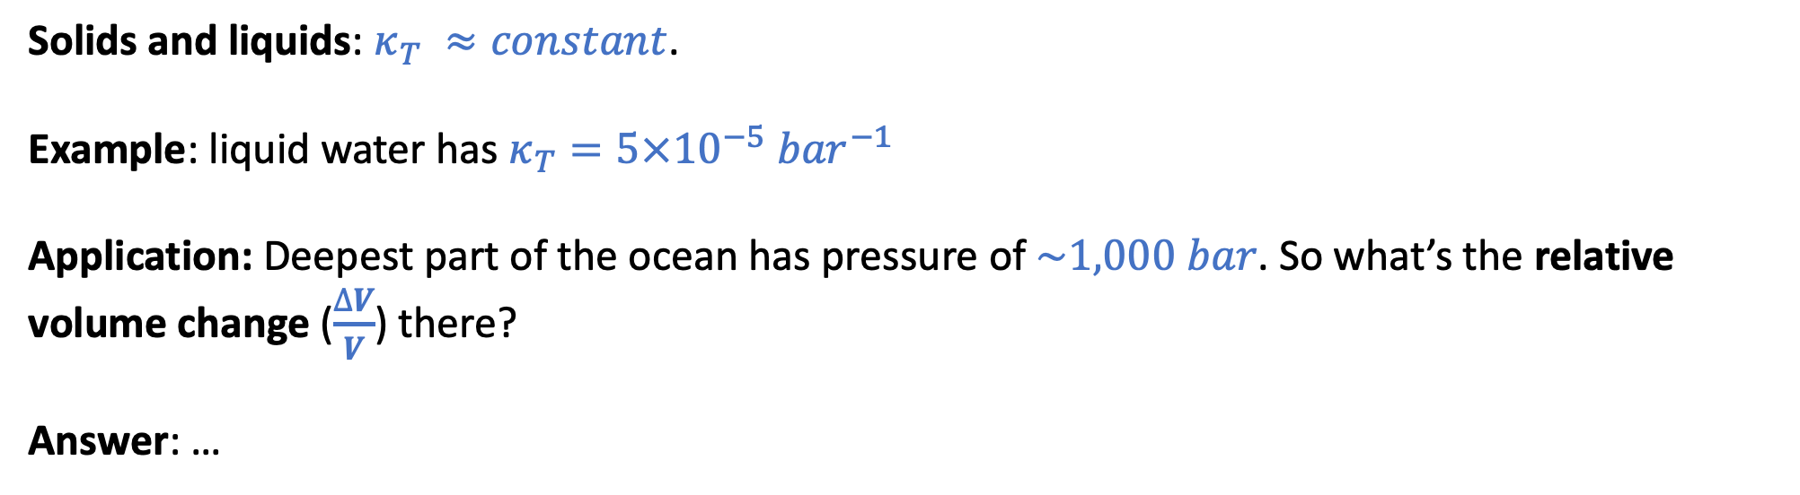
The “Isothermal compressibility”
$κ_{T}≡−\frac{1}{V}{\left(\frac{∂V}{∂P}\right)}_{T}$ … for small changes in temperature, we can say $\frac{∆V}{V}≈{−κ}_{T}∆P$
Solids and liquids: $κ_{T} ≈constant$.
Example: liquid water has $κ_{T}=5×10^{−5}{ bar}^{−1}$
Application: Deepest part of the ocean has pressure of $\sim 1,000 bar$. So what’s the relative volume change ($\frac{∆V}{V}$) there?
Answer: …

Slide 11
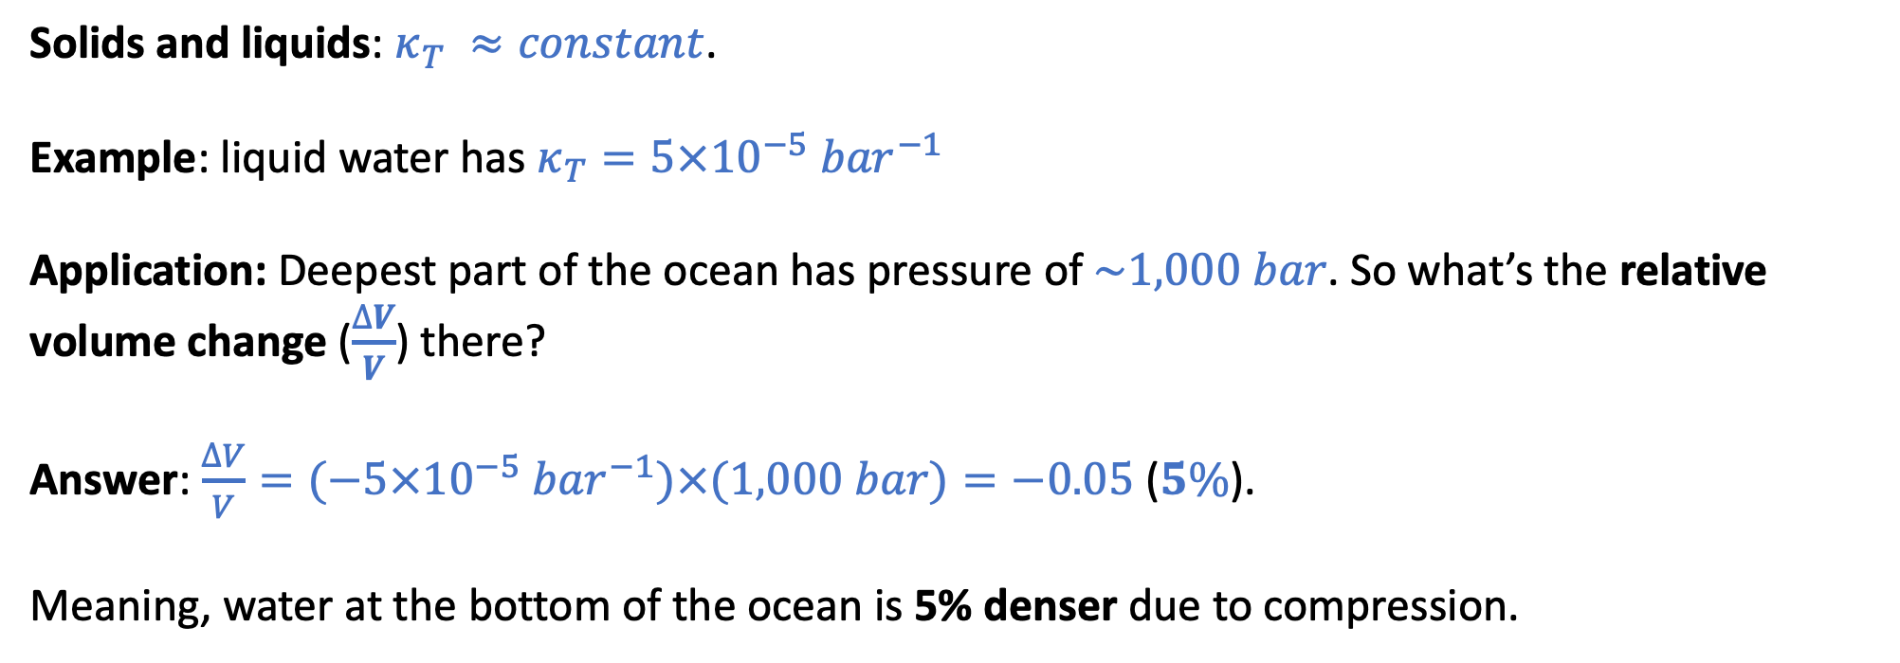
The “Isothermal compressibility”
$κ_{T}≡−\frac{1}{V}{\left(\frac{∂V}{∂P}\right)}_{T}$ … for small changes in temperature, we can say $\frac{∆V}{V}≈{−κ}_{T}∆P$
Solids and liquids: $κ_{T} ≈constant$.
Example: liquid water has $κ_{T}=5×10^{−5}{ bar}^{−1}$
Application: Deepest part of the ocean has pressure of $\sim 1,000 bar$. So what’s the relative volume change ($\frac{∆V}{V}$) there?
Answer: $\frac{∆V}{V}=(−5×10^{−5}{ bar}^{−1})×(1,000 bar)=−0.05$ ($5\%$).
Meaning, water at the bottom of the ocean is 5% denser due to compression.

Slide 12
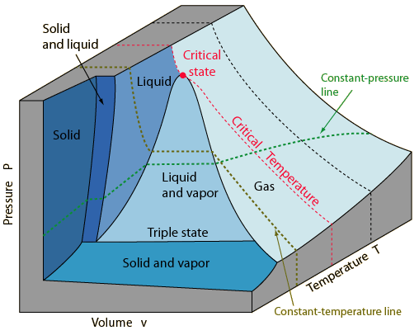
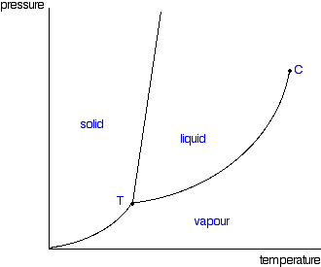

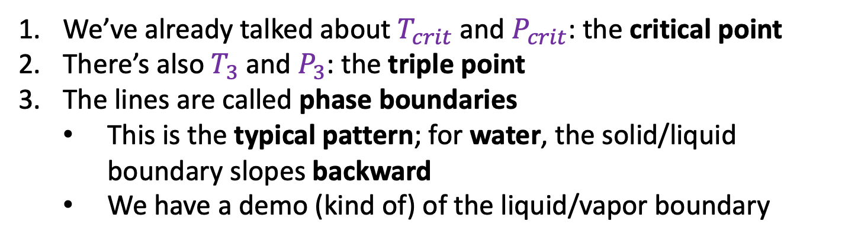

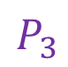
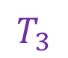
Phase diagrams
$$P_{3}$$
$$T_{3}$$
$$T_{crit}$$
This is a typical phase diagram
We’ve already talked about $T_{crit}$ and $P_{crit}$: the critical point
There’s also $T_{3}$ and $P_{3}$: the triple point
The lines are called phase boundaries
This is the typical pattern; for water, the solid/liquid boundary slopes backward
We have a demo (kind of) of the liquid/vapor boundary

Slide 13
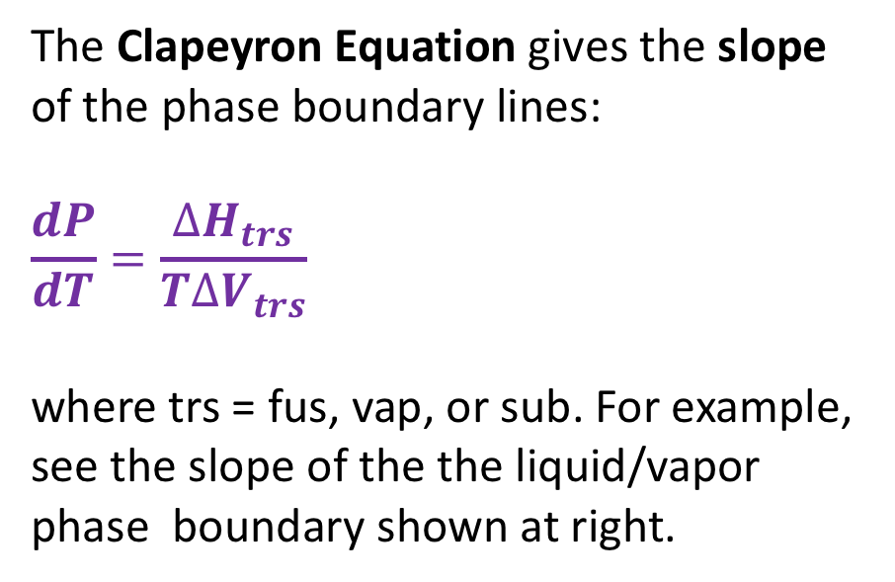
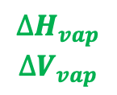
Clapeyron equation
The Clapeyron Equation gives the slope of the phase boundary lines:
$$\frac{dP}{dT}=\frac{∆H_{trs}}{T∆V_{trs}}$$
where trs = fus, vap, or sub. For example, see the slope of the the liquid/vapor phase boundary shown at right.
$$∆H_{vap}$$
$$∆V_{vap}$$
We’ll derive this equation later. For now we’ll just use it to obtain expressions for the phase boundary lines themselves – by integrating the slope.

Slide 14
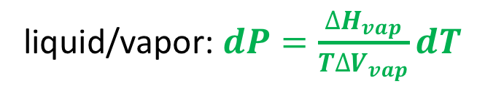
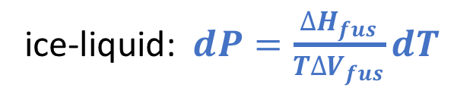
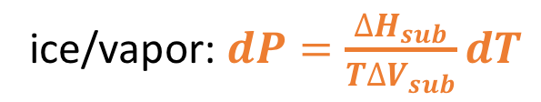
Integrating the Clapeyron Equation
It makes sense to start integration at the triple point because we know $T_{3}$ and $P_{3}$ very accurately
ice-liquid: $dP=\frac{∆H_{fus}}{T∆V_{fus}}dT$
P
liquid/vapor: $dP=\frac{∆H_{vap}}{T∆V_{vap}}dT$
T
ice/vapor: $dP=\frac{∆H_{sub}}{T∆V_{sub}}dT$

Slide 15
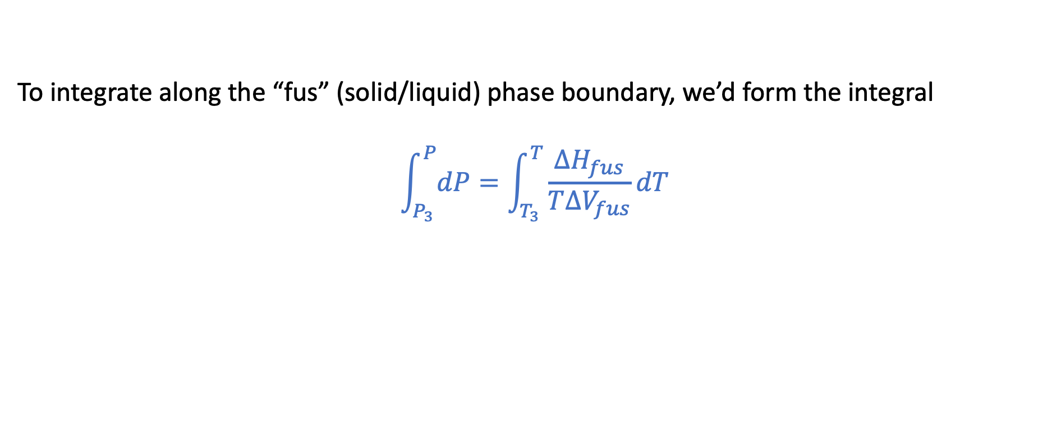
For example, along the solid/liquid phase boundary
P
T
To integrate along the “fus” (solid/liquid) phase boundary, we’d form the integral
$$\int_{P_{3}}^{P}{dP}=\int_{T_{3}}^{T}{\frac{∆H_{fus}}{T∆V_{fus}}dT}$$

